Slide 1
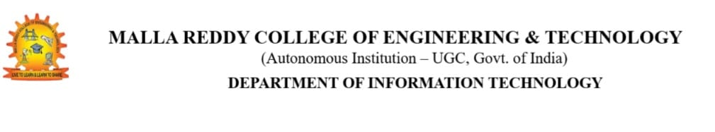
SUDOKU SOLVER
Presenting by Batch-2
N.Chinna - 23N31A3336
Mokshita Mahali - 23N31A3363
A.Sukumar - 23N31A3303

Slide 2







AGENDA
INTRODUCTION
SOFTWARE & HARDWARE REQUIREMENTS FUNDAMENTAL MODULES
OUTPUT SCREENS
SOURCE CODE
CONCLUSION
REFERENCES

Slide 3
INTRODUCTION TO SUDOKU SOLVER
Sudoku is a popular puzzle game where the goal is to fill a 9x9 grid with numbers, making sure each row, column, and 3x3 box has the numbers 1 to 9 without repeating . While it sounds easy, some Sudoku puzzles can be tricky to solve. This project focuses on creating a program that can be solve any Sudoku puzzle automatically.
The main goal is to design a Sudoku solver that takes a partially filled puzzle and quickly fills in the missing numbers. The solver will use smart techniques like backtracking , which tries different numbers until the puzzle is solved correctly.
By building this solver, the project will show how algorithms (step-by-step instructions) can be used to solve problems that require logic and careful planning like Sudoku.

Slide 4
FUNDAMENTAL MODULES
Grid Setup
It helps create the board where numbers will go.
Number Placement
It makes sure not repeating the same numberrs.
Checking Rules
This part checks if the numbers placed are correct.
Solver
This module helps to solve the puzzle using stochastic and tree-based search algorithm.
User Registration & Login
Handles user accounts(registration &login).

Slide 5




REQUIREMENTS
SOFTWARE
HARDWARE
Frontend
HTML,CSS,JavaScript
(for user interface)
Backend
Node.js, java
(for server side logic)
Database
MySQL (for database management)
RAM
1GB RAM is sufficicent
Processor
Any modern CPU with atleast 1Core
Storage
100MB

Slide 6
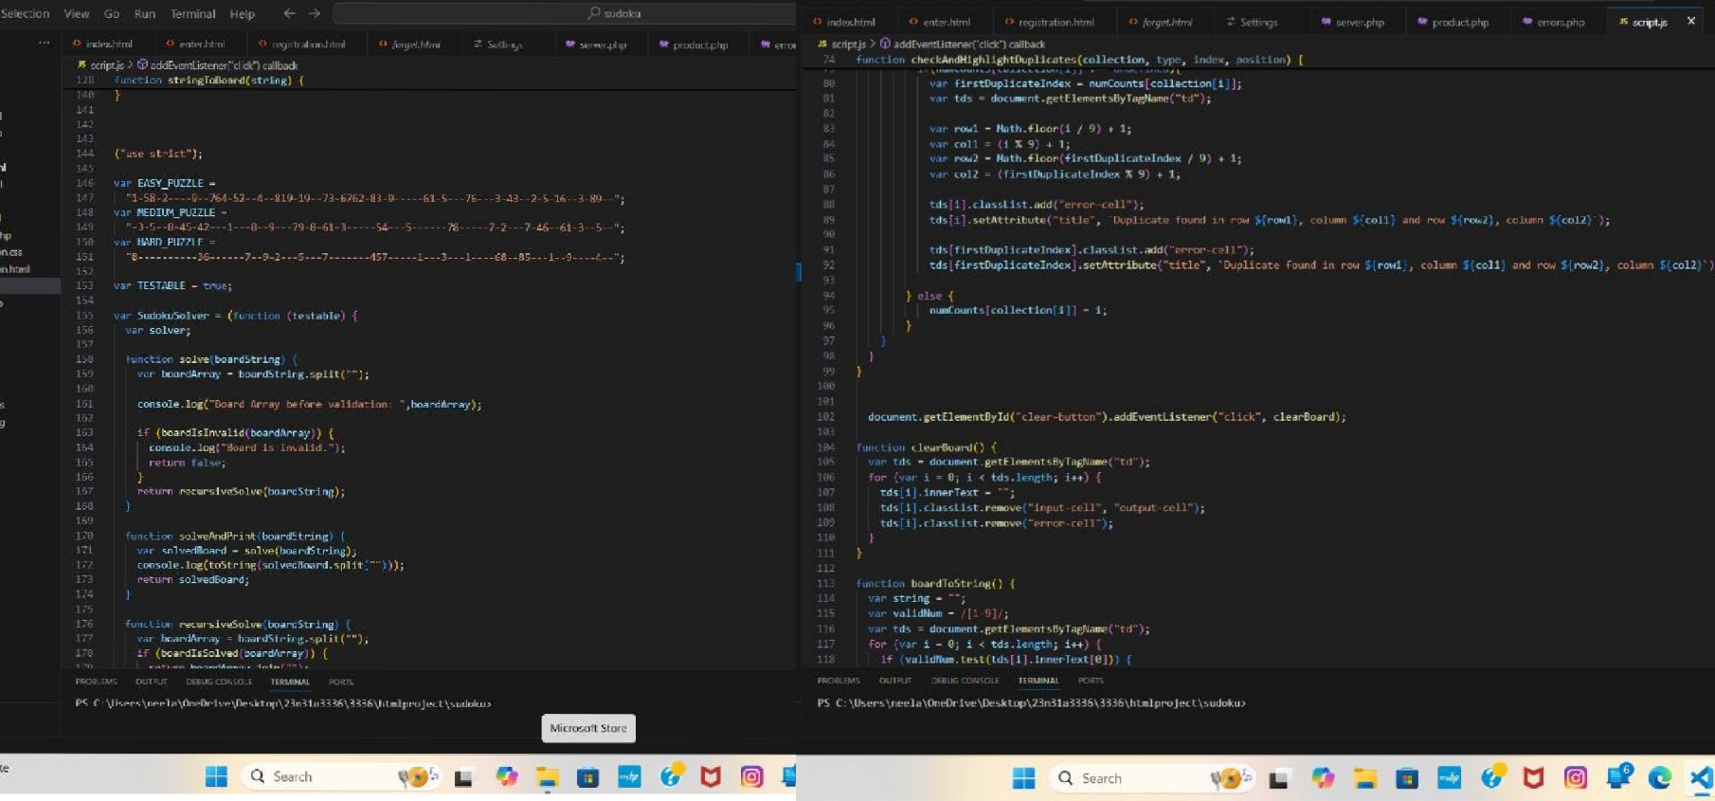
SOURCE CODE

Slide 7
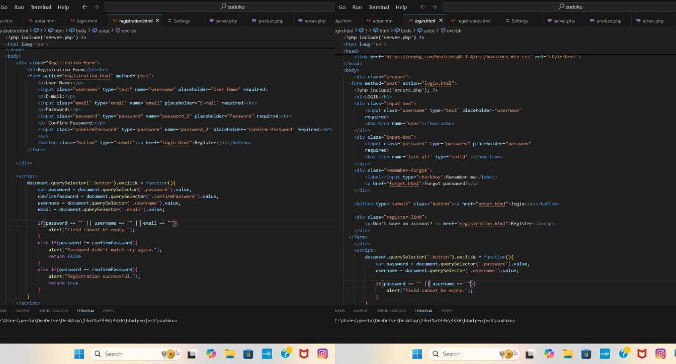

Slide 8
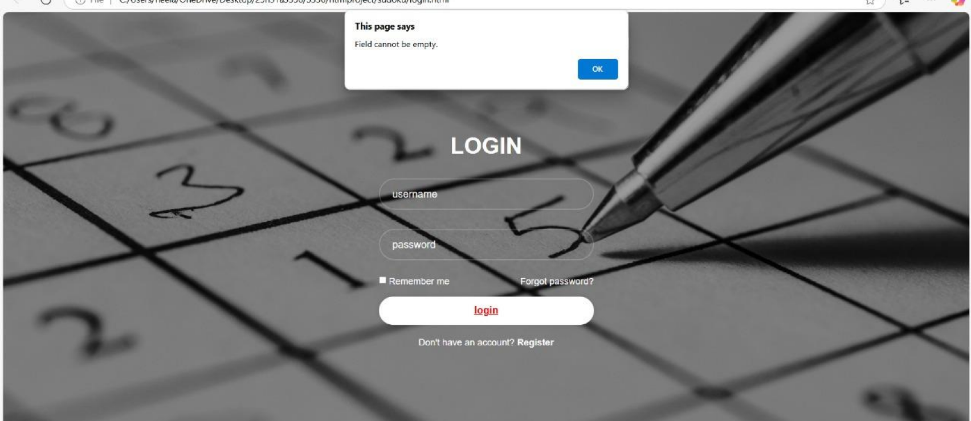
OUTPUT SCREENS

Slide 9
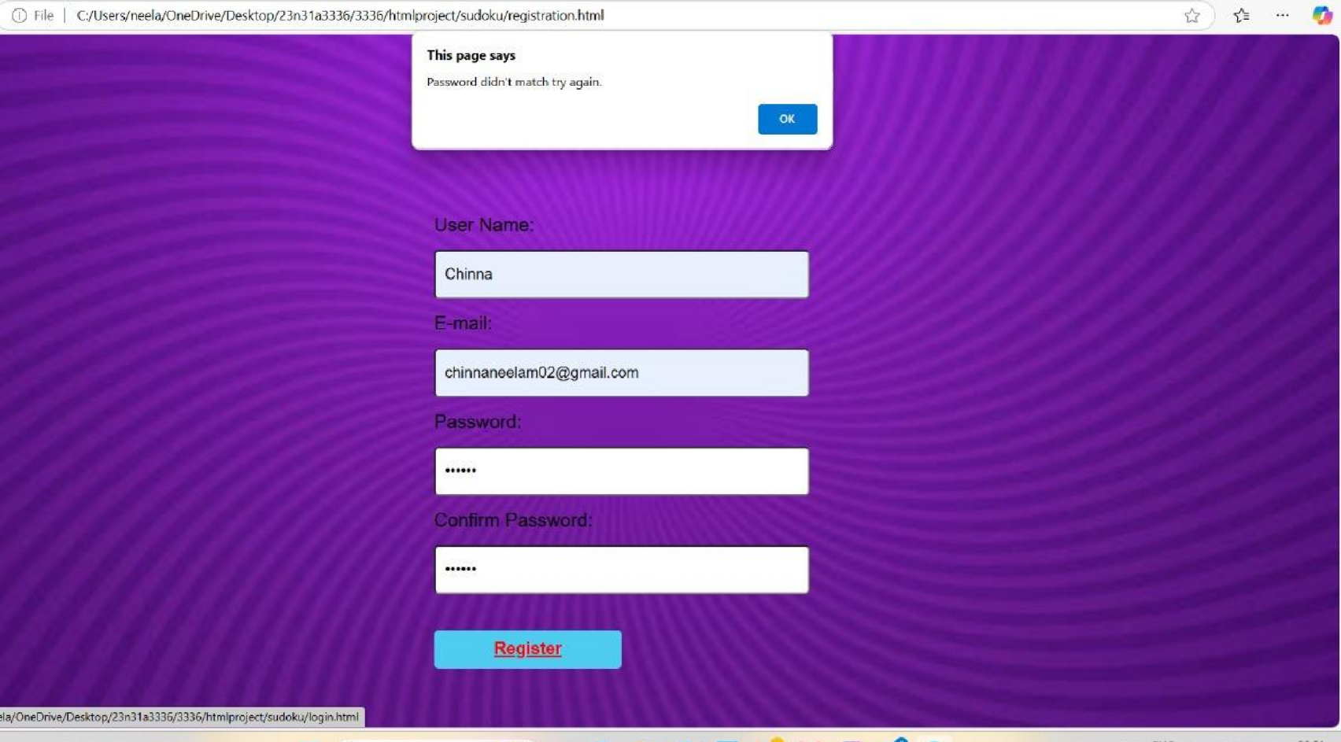

Slide 10
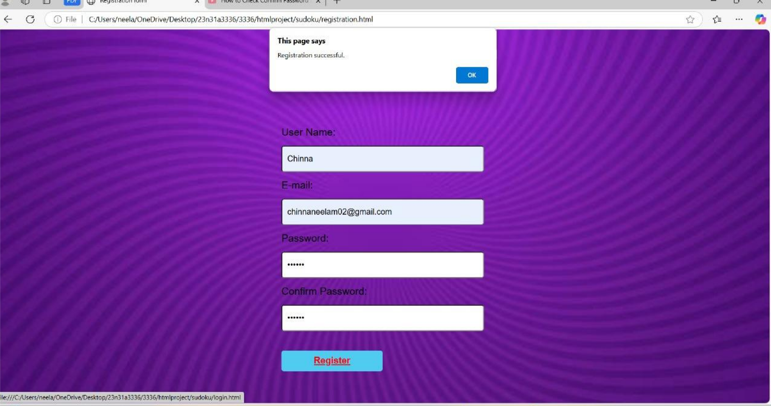

Slide 11
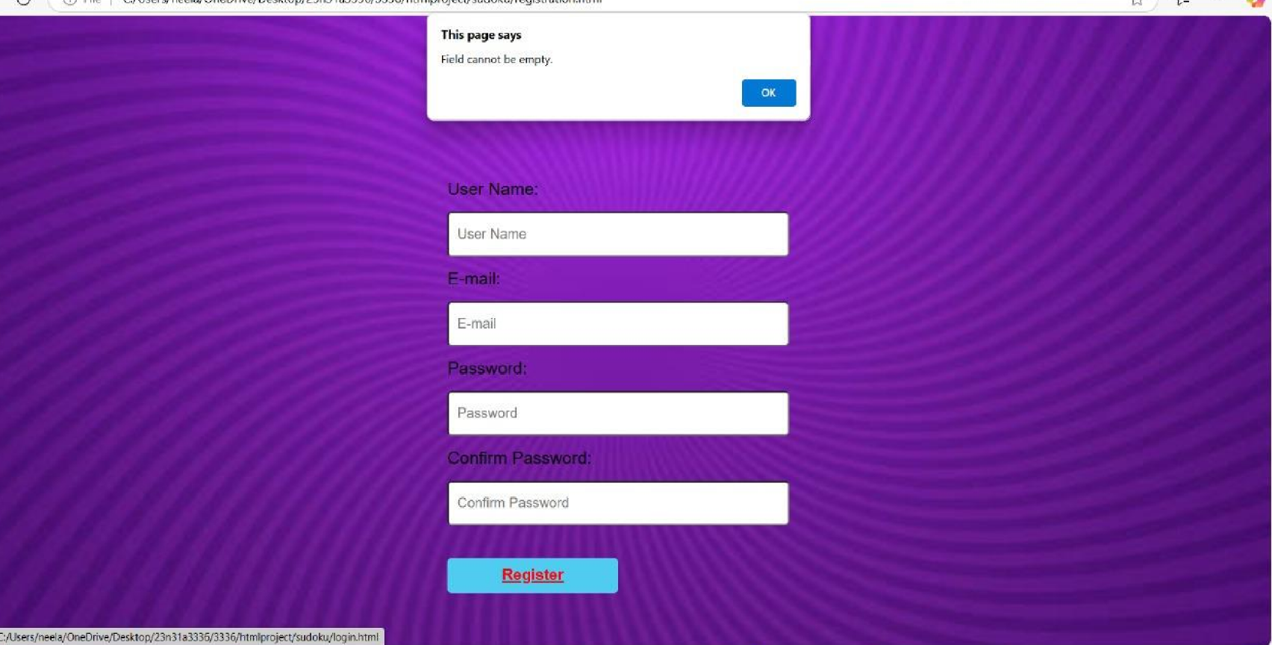

Slide 12
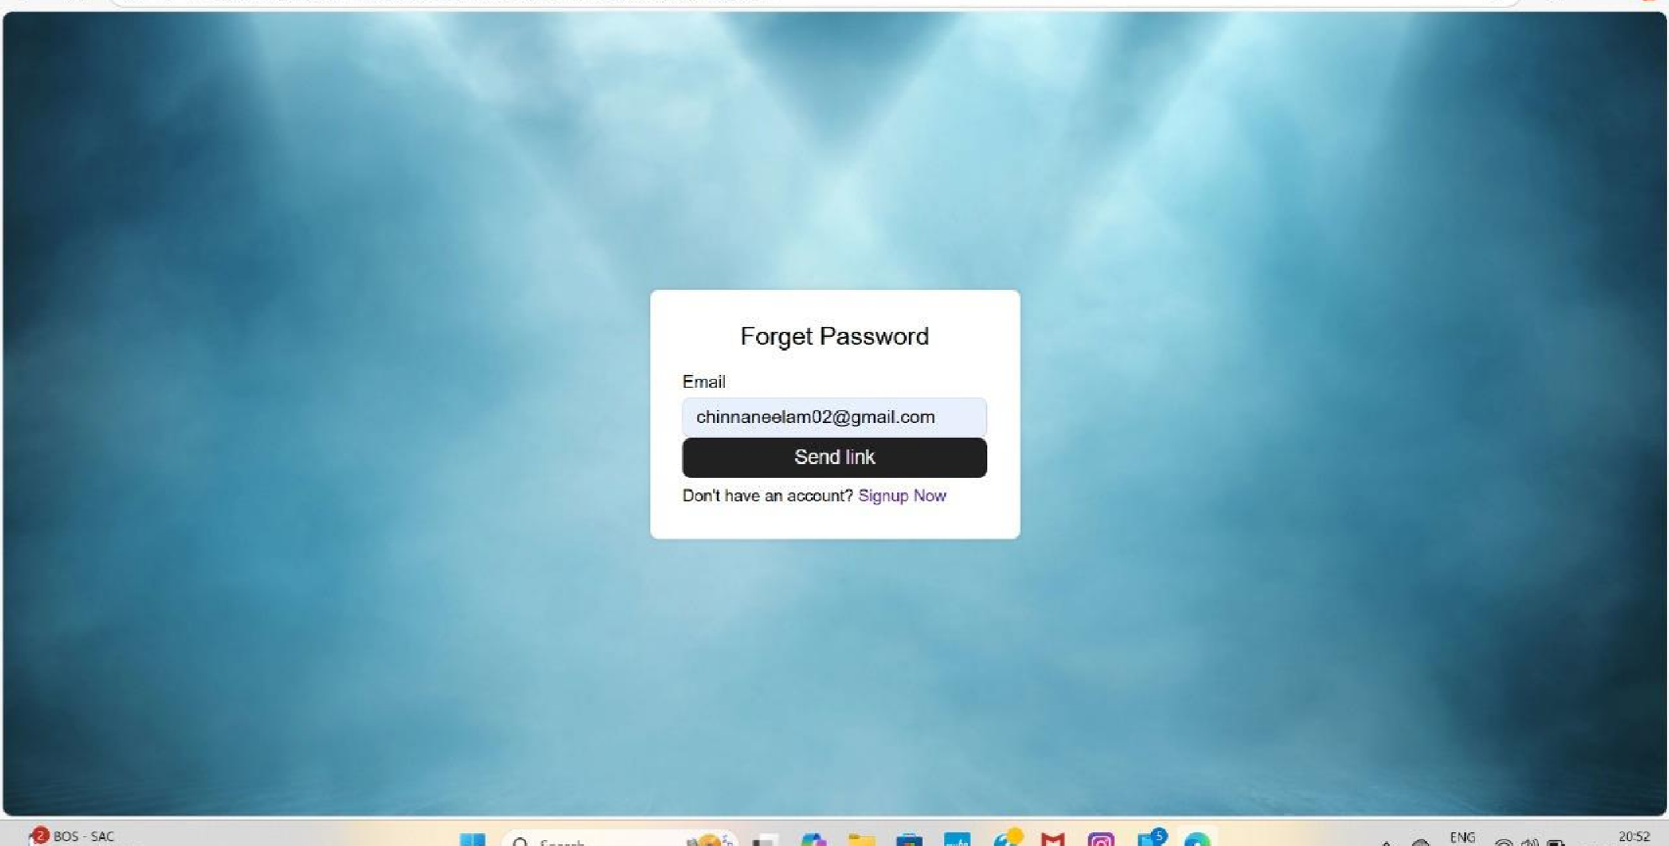

Slide 13
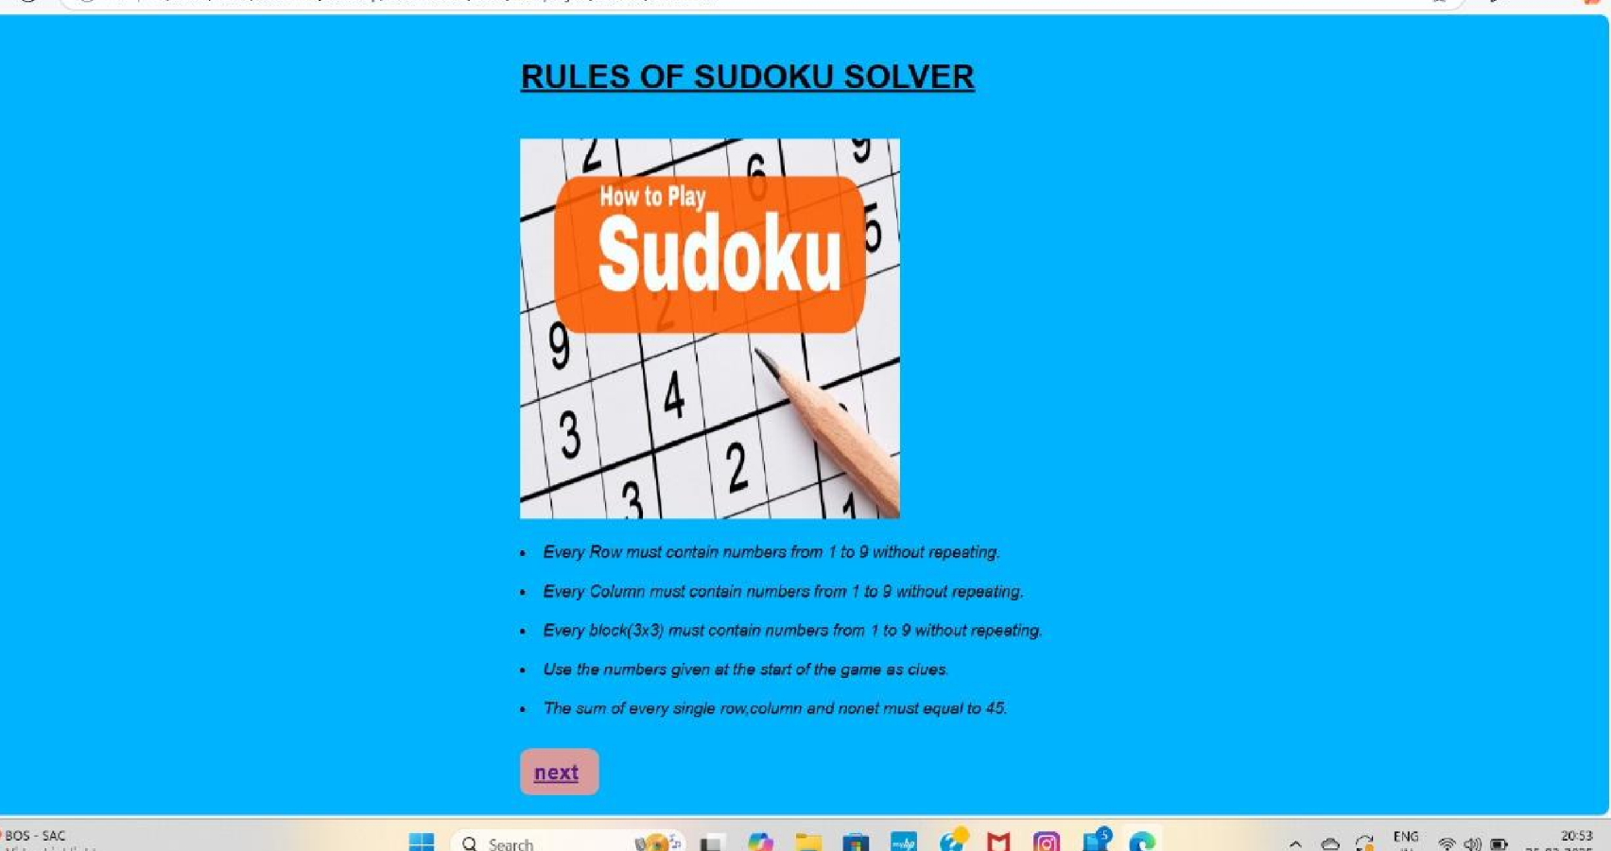

Slide 14
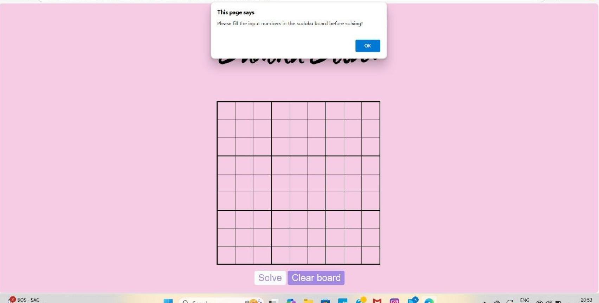

Slide 15
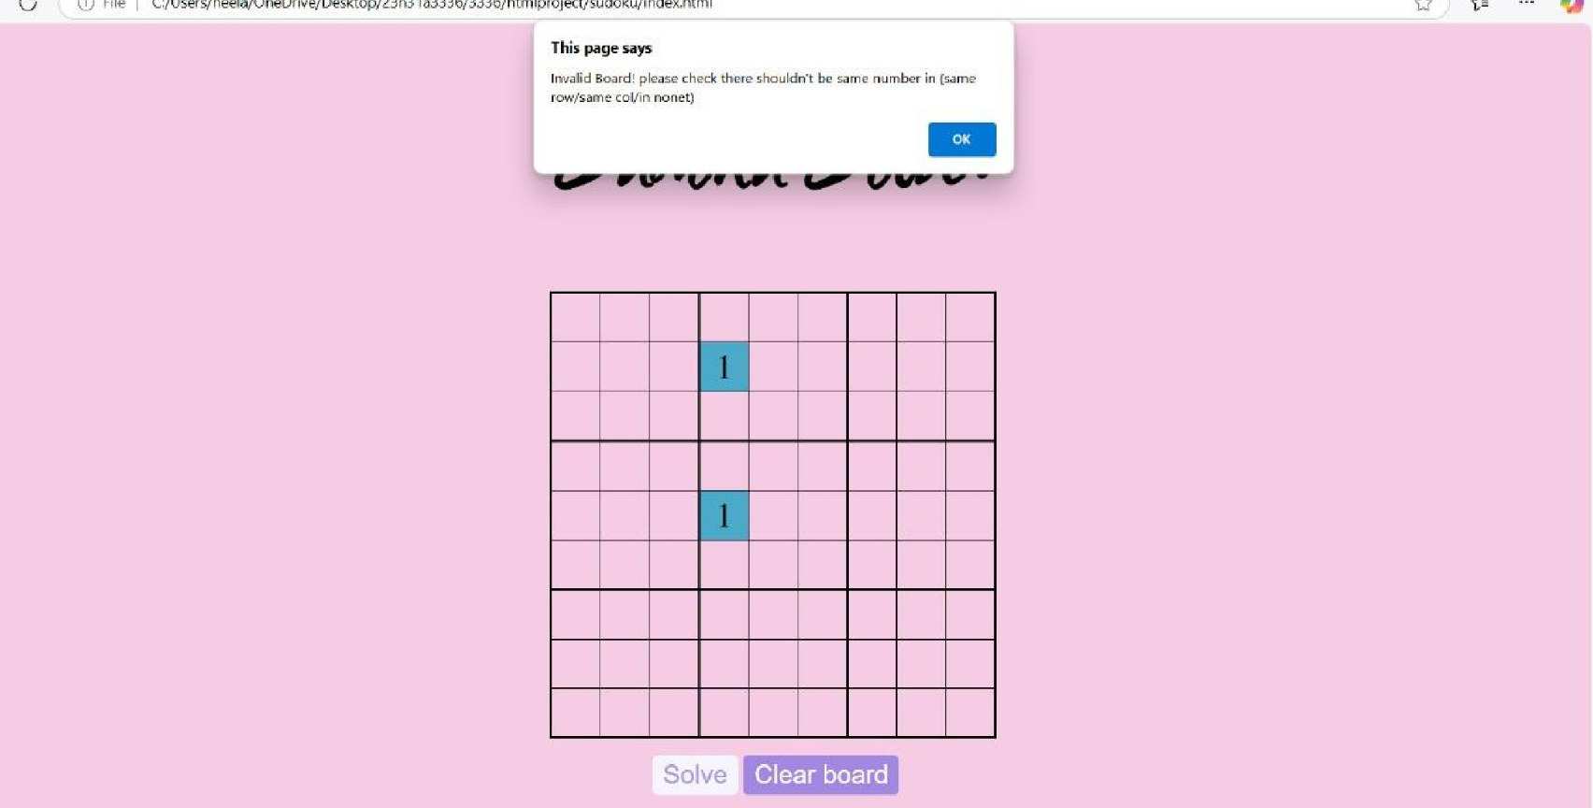

Slide 16
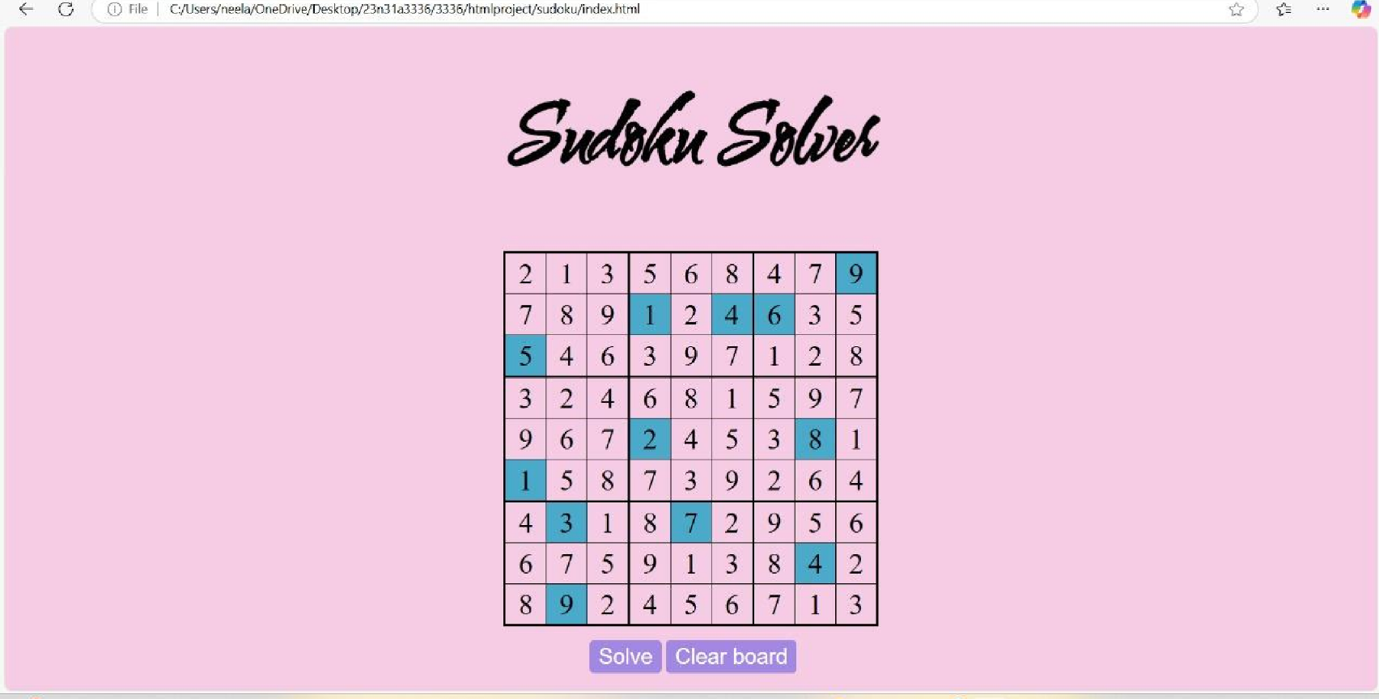

Slide 17
CONCLUSION
The Sudoku solver successfully solves puzzles by using backtracking. It
efficiently fills in the missing numbers while ensuring all Sudoku rules are
followed. The project demonstrates the power of algorithms in solving complex problems and can be further improved to handle even larger or more difficult puzzles.
The solver applies algorithms(such as backtracking, constraint propagation, or optimization techniques) to systematically test possible solutions while ensuring that each row, column and 3*3 sub grid contain all numbers from 1-9 without repetition.

Slide 18


REFERENCES
we have referred this link for JavaScript code:
Sudoku Solver with HTML, CSS, and JavaScript
We have used this link for matching password &confirm password:
https://.youtu.be/bVkl2PJFIA8si=NgGklE75Y2N5tOGm

Slide 19
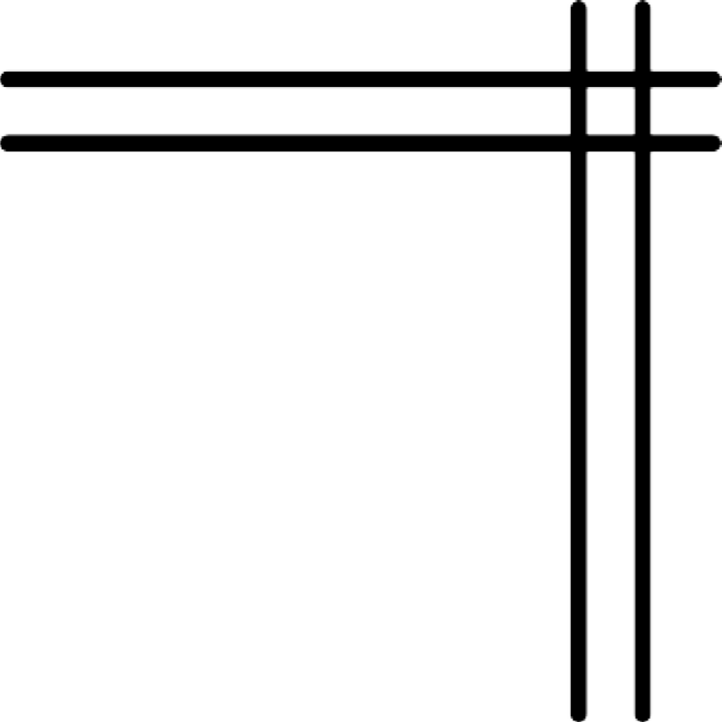
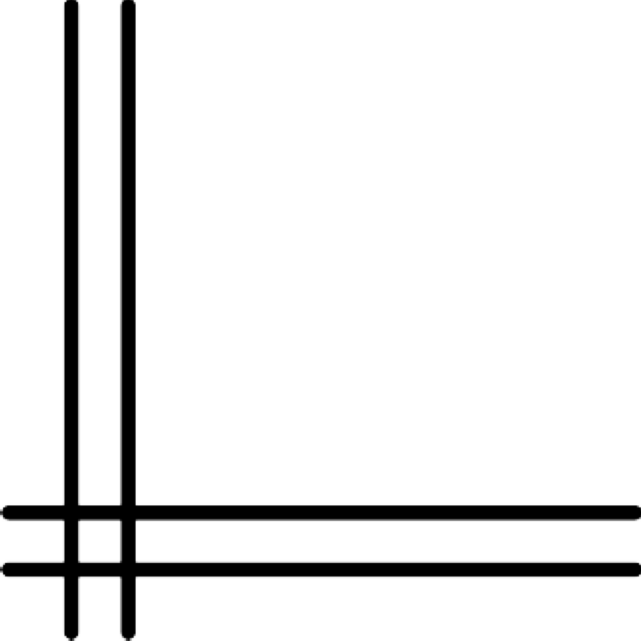
THANK YOU

